Slide 1
Welcome to my presentation
On Numerical Analysis I

Slide 2

Dr. Md Manjur Ahmed Associate Professor
Submitted to
Department of Computer Science & Engineering
University of Barishal.

Slide 3
Submitted by -
Nusrat Jahan Akhi Department of Mathematics
University of Barishal
Batch-61

Slide 4




Why we read Numerical Analysis ?
solve problems that are too difficult to solve analytically in

Slide 5
INTERPOLATION & EXTRAPOLATION
Year | 2017 | 2019 | 2021 | 2023
Population | 161793964 | 165516222 | 169356251 | 172954319
Do you know how many people had in Bangladesh in 2020?
Do you know how many people will have in Bangladesh in 2025?

Slide 7
Interpolation
Interpolation & extrapolation are denoted on the graph on the left side.
Extrapolation

Slide 8
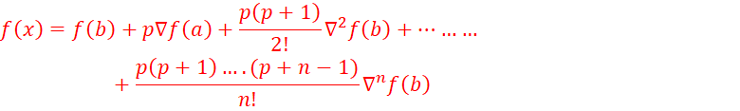
NEWTON’S BACKWARD DIFFERENCE FORMULA
It is a methid of interpolation which is named after it’s inventor “Sir Issac Newton.
This is the way of approximating a function with an $n^{th}$ degree polynomial passing through (n+1) equally spaced points. The formula is given below:
This formula is particularly useful for interpolating the values of f(x) near the end of the set of values given. h is called the interval of difference and u = ( x – a ) / h, Here a is the first term.

Slide 9
ADVANTAGES
The data set can fit exactly for Higher-order polinomilas.
These are simplier to evaluate than the approximations if non-polynomials.
DISADVANTAGES
Sometimes they tend to over fit the data.
It is only applicable for the equidistant values of x.

Slide 10
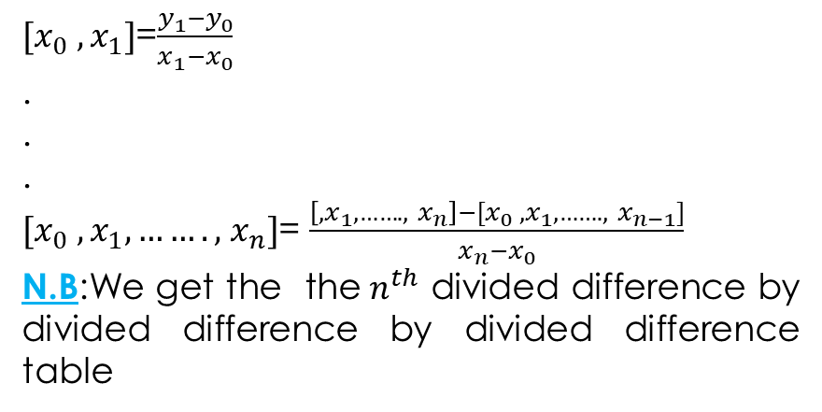
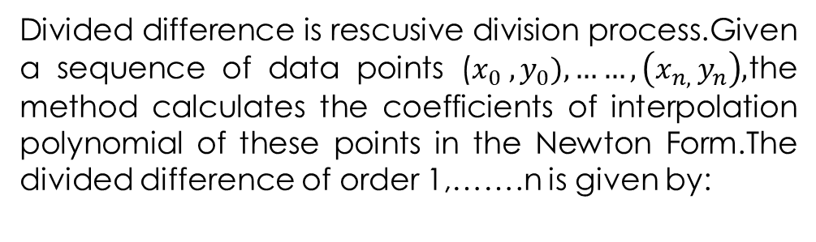
DIVIDED DIFFERENCE
Divided difference is rescusive division process.Given a sequence of data points ($x_{0} ,y_{0}),……,\left(x_{n, }y_{n}\right),$the method calculates the coefficients of interpolation polynomial of these points in the Newton Form.The divided difference of order 1,…….n is given by:
${[x}_{0} ,x_{1}]$=$\frac{y_{1}−y_{0}}{x_{1}−x_{0}}$
.
.
.
${[x}_{0} ,x_{1},…….,$$x_{n}]$= $\frac{\left[,x_{1},……., x_{n}\right]−{[x}_{0} ,x_{1},……., x_{n−1}]}{x_{n}−x_{0}}$
N.B:We get the the${ n}^{th}$ divided difference by divided difference by divided difference table

Slide 11
LAGRANGE’S INTERPOLATION FORMULA
Lagrange interpolation formula is a way to find a polynomial which takes on certain values at arbitrary points.
It is a unique polynomial of lowest degree that interpolates a given set of data.
We can use this formula for both equal & unequal interval.
For the given set of tabulated points ($x_{0} ,y_{0}),\text{(}x_{1} ,y_{1}), .. …,\text{(}x_{n} ,y_{n})$ The formula can be written as,
$y\left(x\right)=\frac{\text{(}x−x_{1})\text{(}x−x_{2}).. \text{..}\text{(}x−x_{n})}{\text{(}x_{0} −x_{1})\text{(}x_{0} −x_{2}).. …\text{(}x_{0} −x_{n})}y_{0}$+$\frac{\text{(}x−x_{0})\text{(}x−x_{2}).. \text{..}\text{(}x−x_{n})}{\text{(}x_{1} −x_{0})\text{(}x_{1} −x_{2}).. …\text{(}x_{1} −x_{n})}y_{1}$+. . . . . . .+$\frac{\text{(}x−x_{0})\text{(}x−x_{1}).. \text{..}\text{(}x−x_{n−1})}{\text{(}x_{n} −x_{1})\text{(}x_{n} −x_{2}).. …\text{(}x_{n} −x_{n−1})}y_{n}$

Slide 12
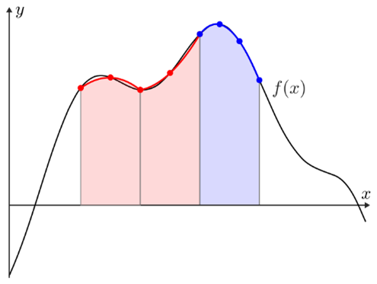
NUMERICAL INTEGRATION
Numerical integration methods can generally be described as combining evaluations of the integrand to get an approximation to the integral. The integrand is evaluated at a finite set of points called integration points and a weighted sum of these values is used to approximate the integral.
By finding the area under the each of the sub-intervals & adding them we get numerical approximation of the integration.

Slide 13
Thank You

